Slide 1
Arduino Workshop #3
Using Transistors and Driving Motors and Servos

Slide 2
PowerPoint and Code
Github.com/EELabMan
Go To Repositories and find Arduino 3 Motors and Servos

Slide 3
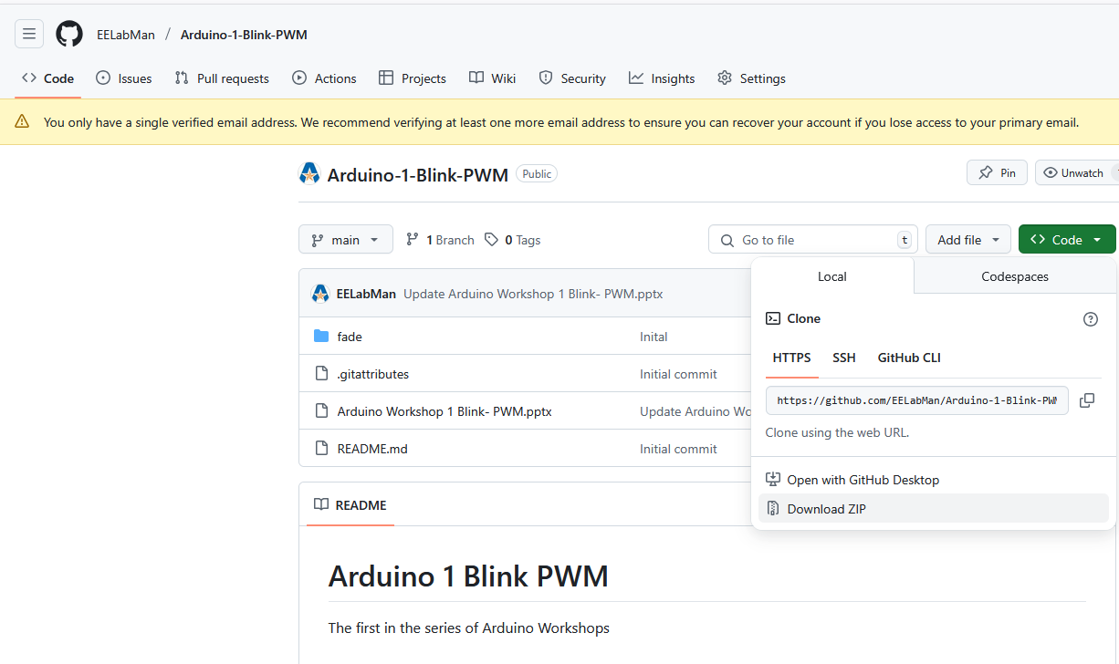
PowerPoint and Code
Click the GREEN code button and download the ZIP folder. BE SURE TO UNZIP THIS FOLDER.

Slide 4
Warning
In this lesson you will be using a 9 volt battery to power motors. This voltage is not physically dangerous, but if hooked up improperly could damage the electronics in the circuit. When wiring your circuits you should avoid short circuiting (connecting power directly to ground) and you should not hook up two separate voltage sources to each other (DO NOT hook the 9 v and Arduino 5 v to the same power row on the bread board)

Slide 5
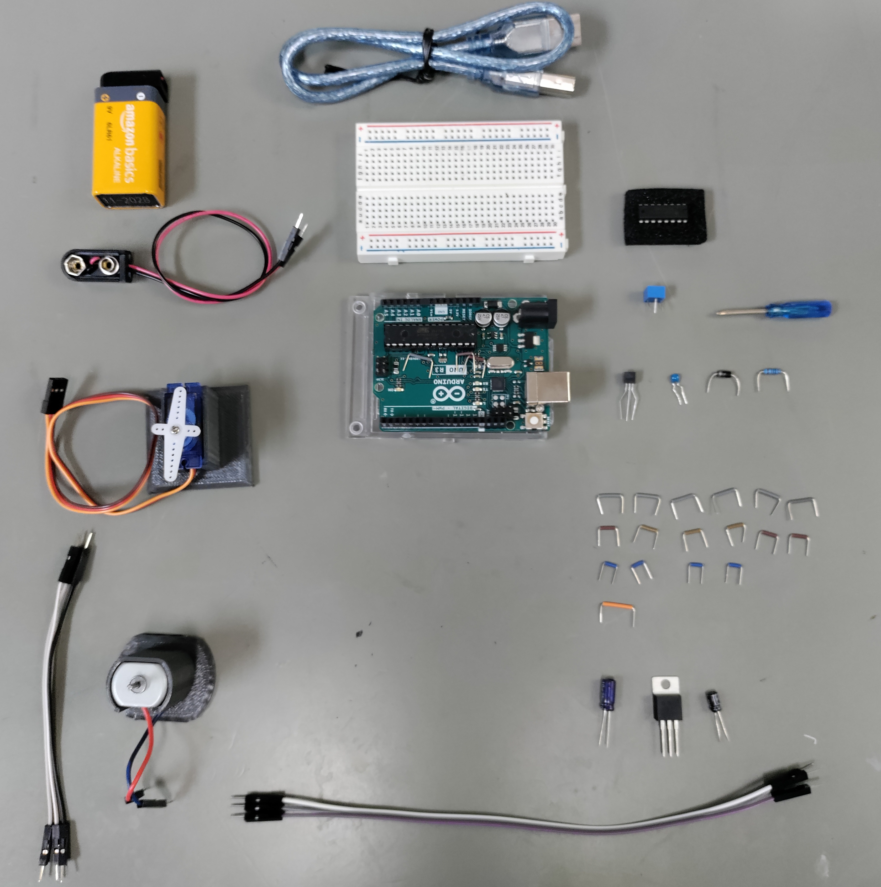
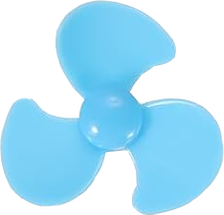
Parts
USB Cable
Breadboard
9V battery with protective cap
H-Bridge Chip
Potentiometer
Screwdriver
9V battery connector
2N2222 Transistor
1 uF capacitor
1K ohm resistor
Servo Motor w/ stand
Arduino UNO
1n4004 Diode
3 short male to male
6 grey breadboard wires
6 brown breadboard wires
4 blue breadboard wires
DC Motor w/ stand
1 orange breadboard wires
0.1 uF capacitor
Fan
3 long male to male
10 uF capacitor
5V regulator 7805

Slide 6
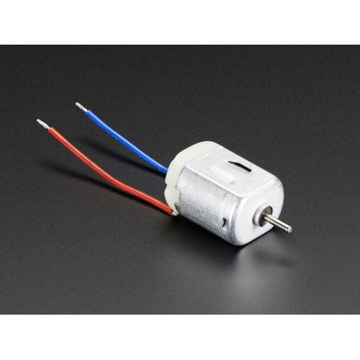
What is a “DC Motor”?
DC motors
Found in devices around your house
Rotate continuously when a dc voltage is applied to them
Come in an array of sizes
Very cheap to produce
Rotation is dictated by the voltage applied to them
Lower voltage -- slower speed
Reverse voltage -- reverse direction of rotation
Two main types
brushed
Employ stationary magnets and spinning coil
Electricity is transferred to the coil via “brushes”
Cheaper
Wear out more easily
Brushless
Work using inductive forces to rotate
Can generate electricity if manually rotate the rotor
Example stepper motors

Slide 7
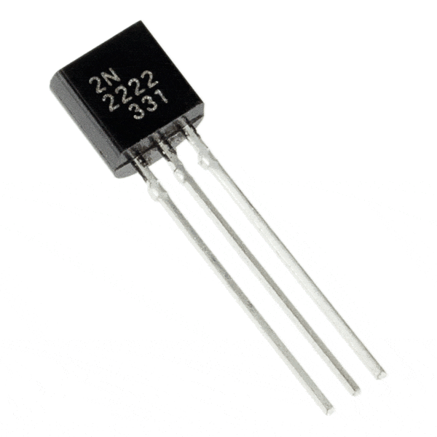
Handling High current inductive loads
DC motors generally require more current than an Arduino can provide
Can create harmful voltage spikes
We need to isolate them from our Arduino
Transistor allows the safe switching of motors state
We can control the speed using PWM (as learned earlier)

Slide 8
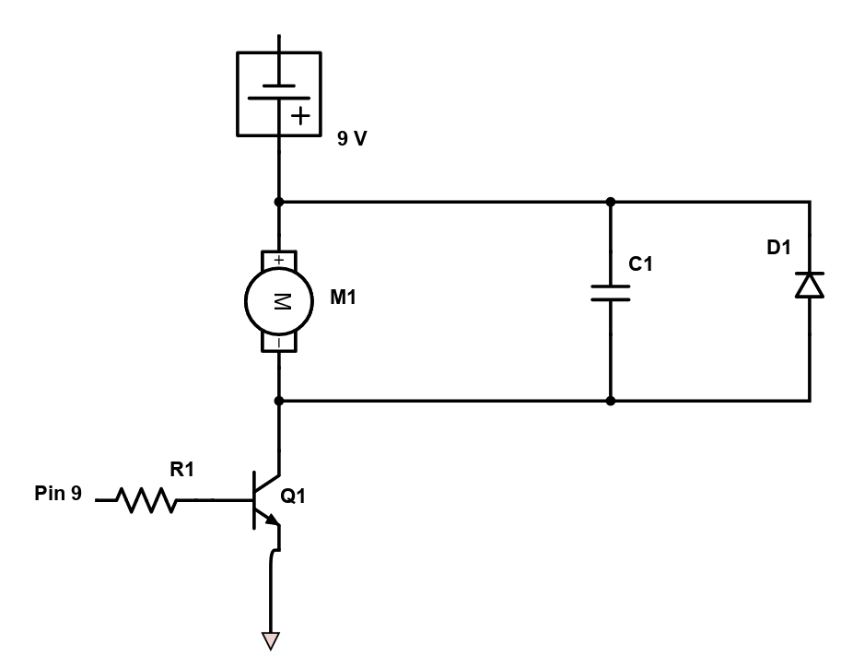
Schematic
Before we hook up a motor let's take some time to look at each component
Q₁ - NPN transistor
A “voltage controlled switch”
R₁ - 1 ㏀ resistor
separates the transistor from the Arduino
M₁ - The DC motor
C₁ - 1 µF capacitor
filters noise caused by the motor
D₁ - diode
Protects the power supply from reverse voltage caused by the induction of the motor

Slide 9
Using transistors as a switch
A transistor is a device that regulates current or voltage flow and acts as a switch or gate for electronic signals
We are using Bipolar junction transistors (BJT)
Each BJT has 3 pins
Emitter
Collector
Base
Current flows through the collector and out the emitter
By changing the base pin voltage you can control when current is allowed to flow thought the emitter – collector path
5 v applied to the base will short circuit the emitter- collector

Slide 10
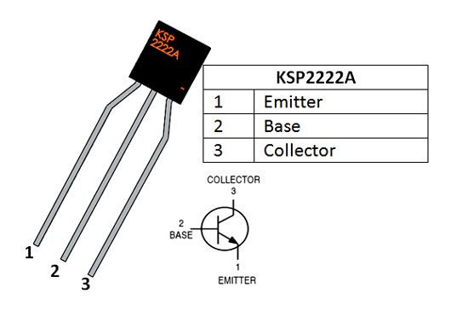
Labeled transistor Pic

Slide 11
Protection Diodes
It is important to consider issues caused by DC motors
DC Motors act as inductors
Electrical devices that store energy in a magnetic field and resist changes in current
As they spin they build up energy as inductance in the magnetic coils
When the power is removed this energy is released
Inverted voltage spike
This is where we need a diode
Diodes only allow current to flow in one direction
By placing it in parallel with the motor the reverse voltage cannot exceed the forward voltage

Slide 12
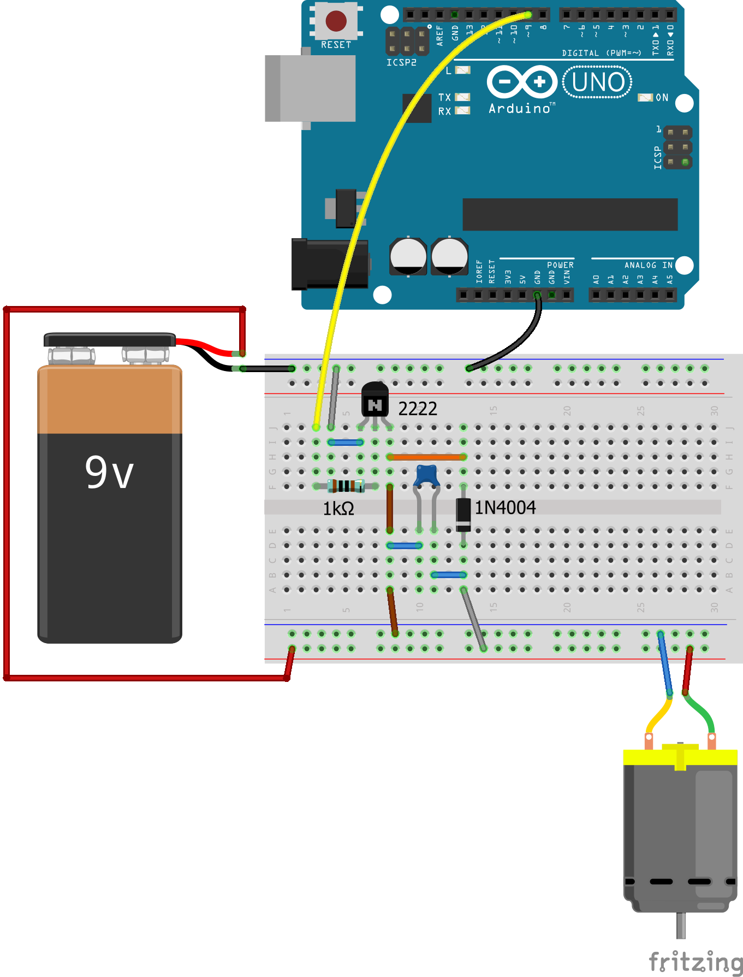
Let’s wire the circuit
Ensure the parts are in the correct columns and rows. Zoom in to see more clearly. Note the polarity of the diode.
Breadboard wires are colored correctly for the length you will need.
Male to Male jumpers are not colored to match the layout. Any color will do.
Install the fan blade to the rotating shaft so you can visually see the rotation
Remove the protective cap off the 9V battery.
1uF

Slide 13
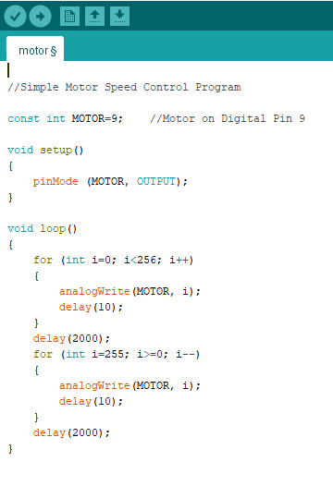
And the code to make it run
Open motor.ino from the unzipped Arduino Workshop 3 Motors and Servos folder and upload it to the Arduino
Notice it’s just like when we were brightening and dimming the LED from the first workshop. We just call it MOTOR now.

Slide 14
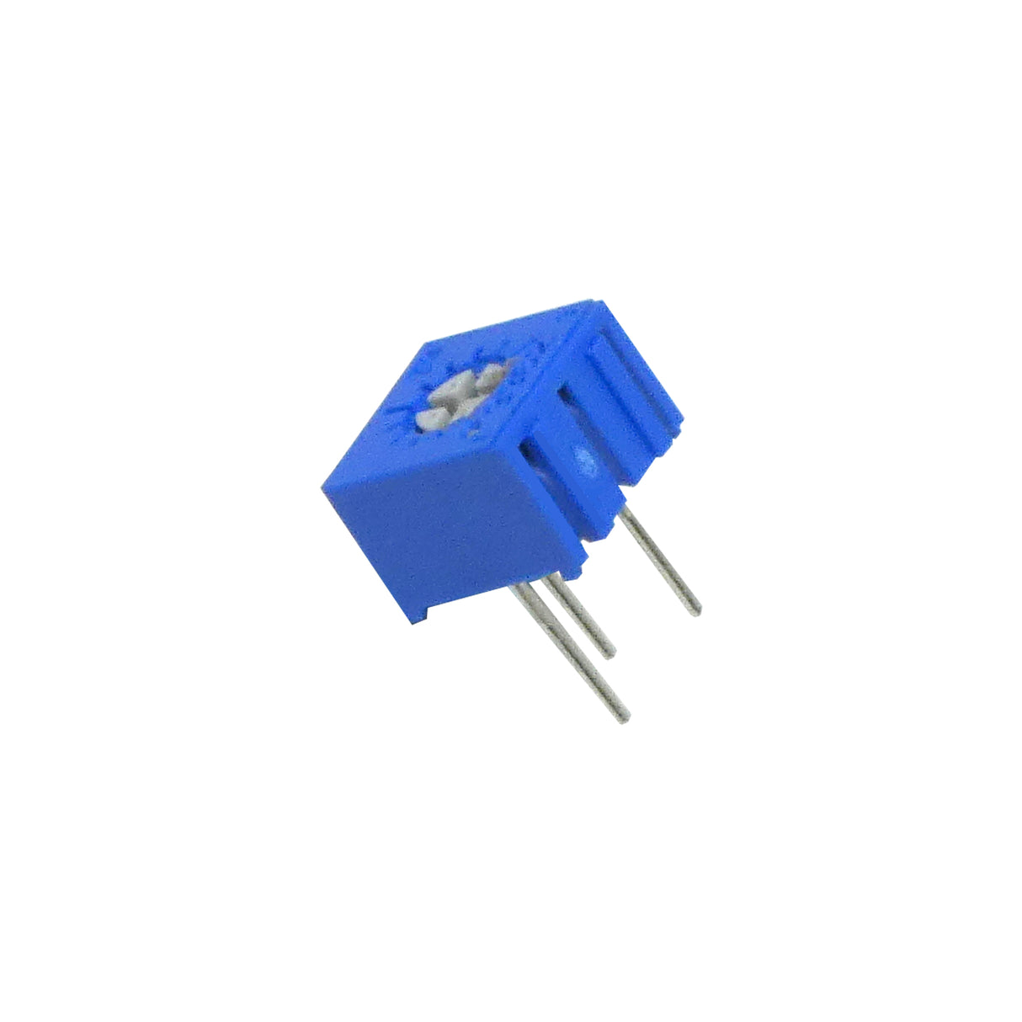
Let's add to it
By combining our new knowledge of DC motors and our previous knowledge of analog sensors
We can add a potentiometer to manually adjust the motor speed

Slide 15
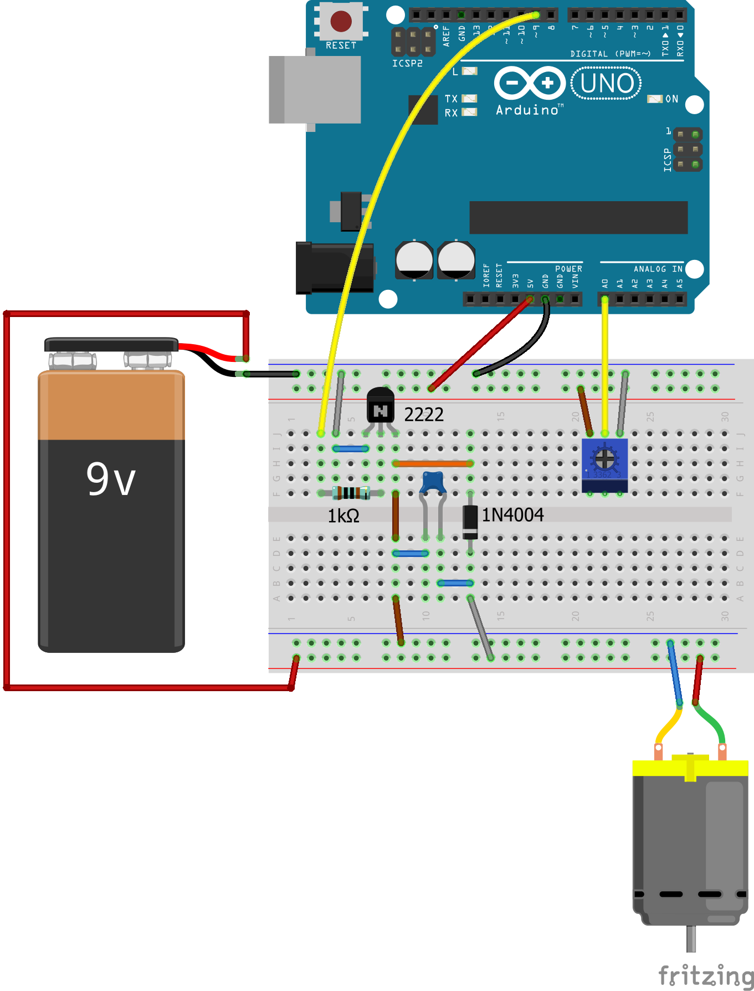
Wire it up
Install a male to male jumper from the Arduino 5V pin to the red power rail of the breadboard. ENSURE the GND and 5V jumpers are on different power rails! You must keep them separated!
Insert the blue potentiometer and connect one side to the 5V rail and the other side to the GND rail.
Use a male to male jumper to connect the center pin of the pot to the A0 analog in pin of the Arduino.

Slide 16
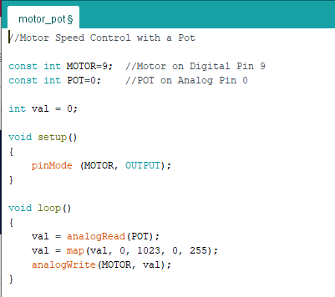
Change the code a bit
Open motor_pot.ino from the unzipped folder and upload it to the Arduino.
Use the screwdriver to turn the potentiometer.
The code reads the voltage of the A0 pin and give it a value from 0 – 1023.
The map function converts this range to 0 – 255 and sends this PWM value to the motor.

Slide 17
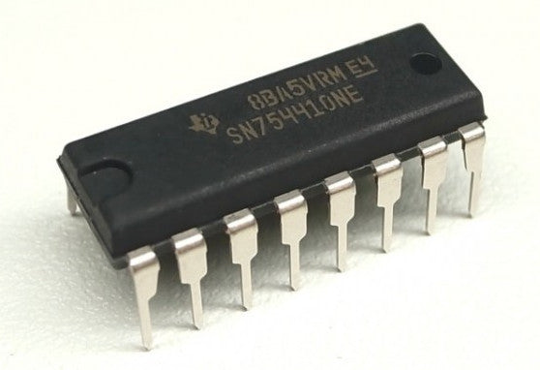
Using an H bridge to control direction
Until now we have been spinning in one direction
What if we want to change the direction of spin?
The H- Bridge accomplishes this

Slide 18
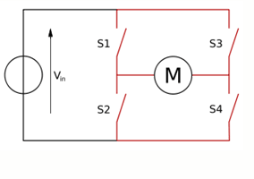
Whats an H-Bridge?
By closing any 2 switches the motor responds differently
Close S₁ & S₄
Motor spins one direction
Close S₂ & S₃
Motor spins the opposite direction
Close S₁ & S₂
SHORT CIRCUIT!
Close S₃ & S₄
SHORT CIRCUIT!

Slide 19
Warning
Be aware of the main issues that plague an H-Bridge.
A direct short to the power source (closing S₁ & S₂).
Because we are using a 9 V battery, a shorted battery heats up and could cause a leak or fire
To ensure you don't blow anything up, always disable the chip with the software before switching the state of any switches

Slide 20
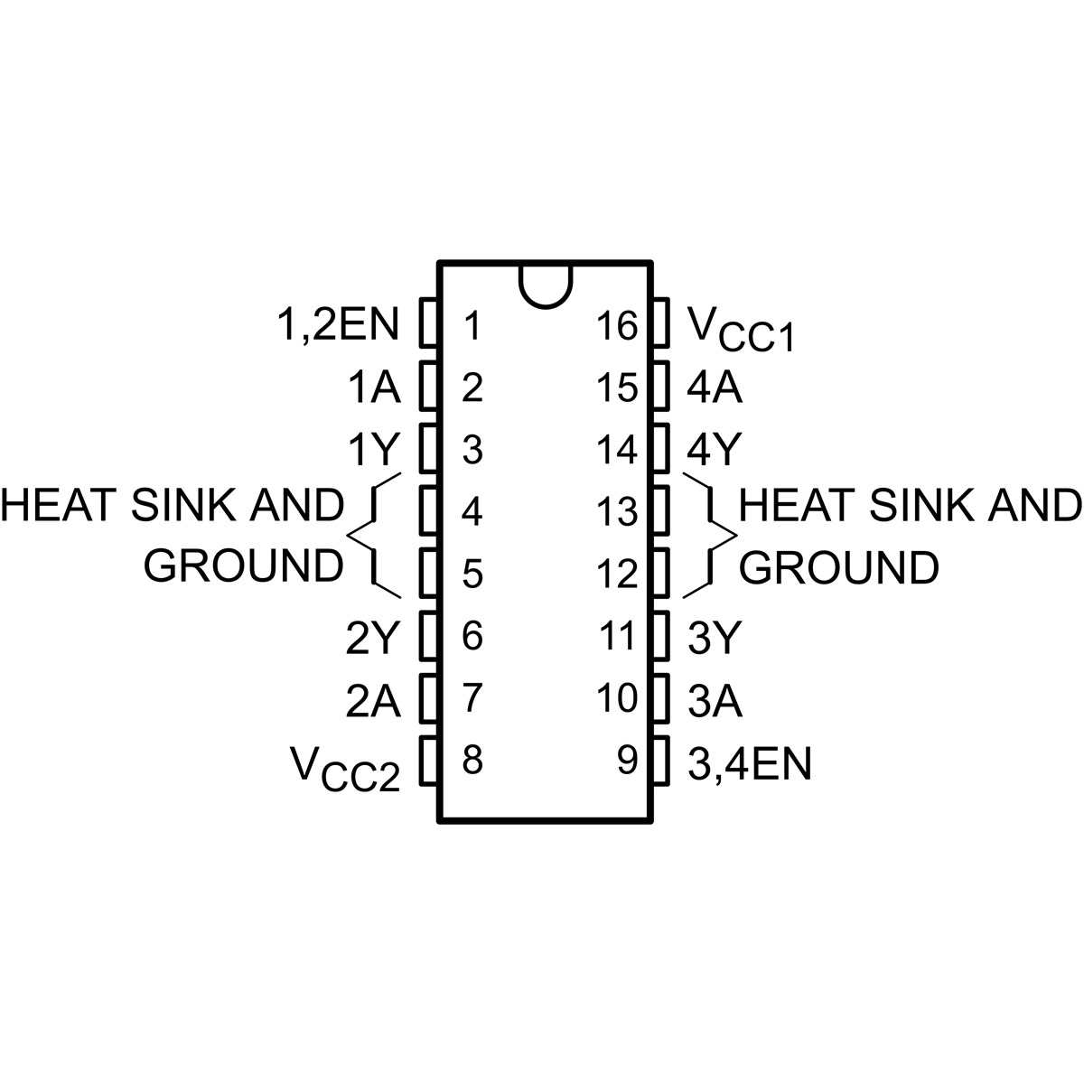
H-bridge Pinout
Integrated circuits (ICs) are numbered from top left counter clockwise
There is always an indication of top of the chip
Notice the “half circle”

Slide 21
How to understand the H-Bridge
Which pins we are using
GND (pins 4,5,12,13)
These pins connect to a shared ground
V_{cc2} (pin 8)
Supplies motor current (connect to 9 V)
V_{cc1} (pin 16)
Supplies chip logic power (connect to 5 V)
1Y & 2Y (pins 3 & 6)\
Output for the left driver (connect to motor)
1A &2A (pins 1 & 7)
State definition pins (connect to Arduino to toggle state)
1,2En (pin 1)
Enables or disable left driver (connect to Arduino to control speed dynamically)
3Y &4Y (pin 11 & 14)
Right driver pins (not being used in this project)
3A & 4A
State switches for right driver (not in use this project)
3,4EN
Enables or disable left driver (connect GND for this application)

Slide 22
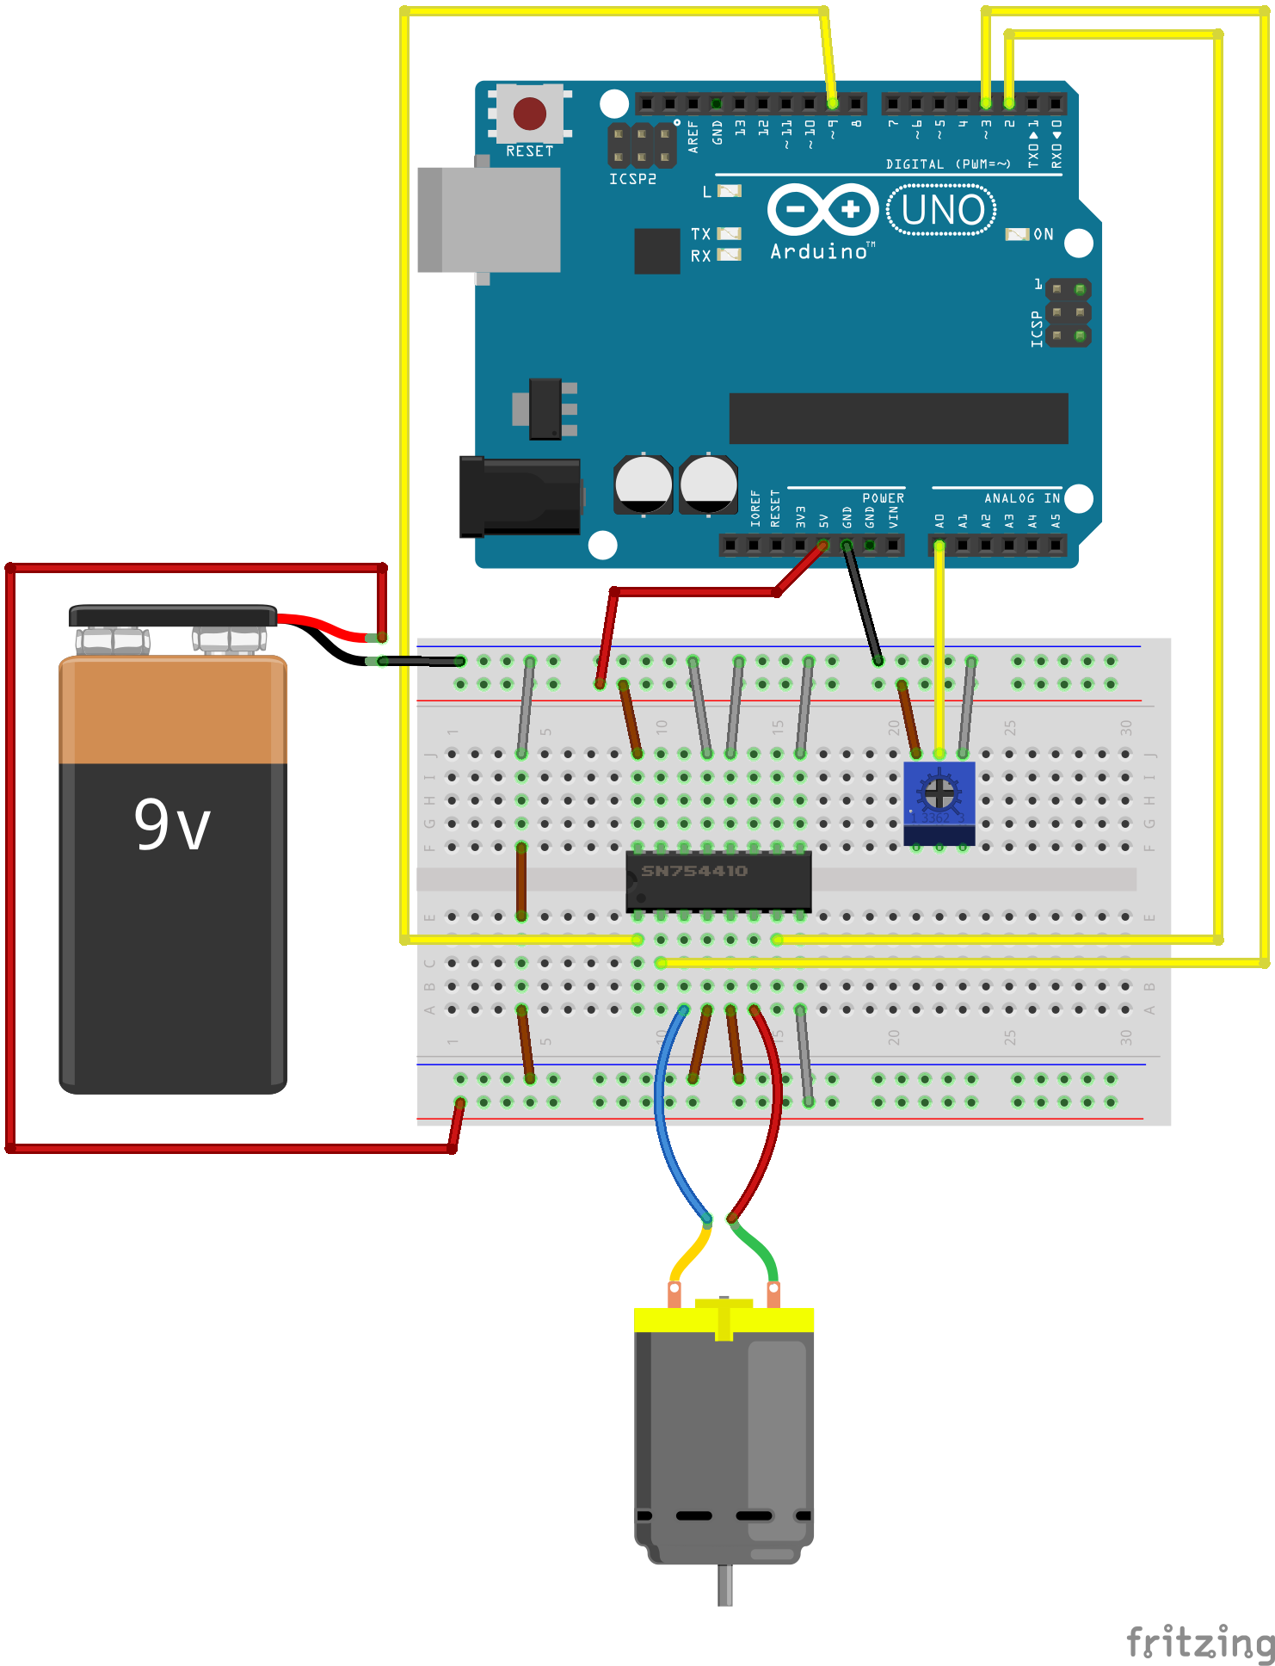
Lets wire it up
The 16 pin IC Chip has a notch on the left side by pin 1 to . Pin 1 should be in the lower left corner.

Slide 23
Open and run hbridge.ino
Note for each function:
EN is always set low then the MC1 And MC2 is adjusted
By using PWM we can change the duty cycle
rate must be between 0 and 255 (this happens in the main loop)

Slide 24
Driving servos

Slide 25
Servos
DC motors are fine if you don't need feedback
You never know exactly where they are in their rotation
Servos solve this by rotating to a specific angle
And then staying at that angle until controlled to a new rotation angle

Slide 26
How servos work
Servos work in two ways
Unmodified
Rotation limited to between 0 and 180⁰
A potentiometer in line with the servo reads a pulse width length and converts that to angle of rotation
The length of the pulse needed is between 1 ms and 2 ms
1 ms 5 v pulse - turns servo to 0⁰
2 ms 5 V pulse - turns servo to 180⁰
1.5 ms 5 V pulse - turns servo to 90⁰
To remain in position (if under load) you can resend the same width pulse every 20 ms
modified
Rotation is uninhibited
With no potentiometer inline, the pulse length dictates servo speed (and it can rotate 360⁰ as needed)
Three pins
Power (usually red)
Ground (usually black)
Signal (usually white or orange)
They can be ran on 5 V but building a separate power supply is common

Slide 27
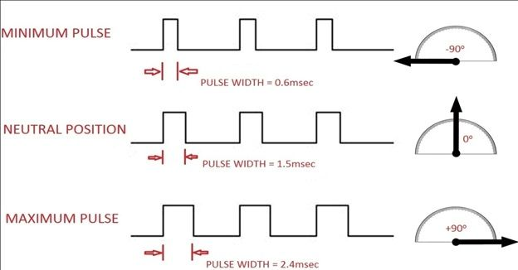
A diagram to clarify

Slide 28
Servos can run on 5 V but need more current
We will employ a linear regulator
Simple device
Has three pins
Input voltage
Must be higher of the voltages used
Output voltage
Lower voltage (set by the regulator being used)
Ground
The drop in voltage results in heat
output is maintained even as the input voltage changes over time (think battery slowly draining)

Slide 29
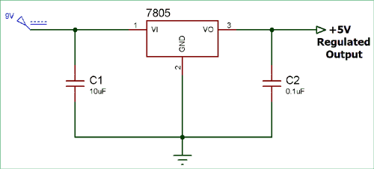
Linear regulator schematic
Notice the capacitors
These are decoupling capacitors
The 5 V rail created needs to be separate from 5 V on the arduino
Ground should be grounded w/ arduino

Slide 30
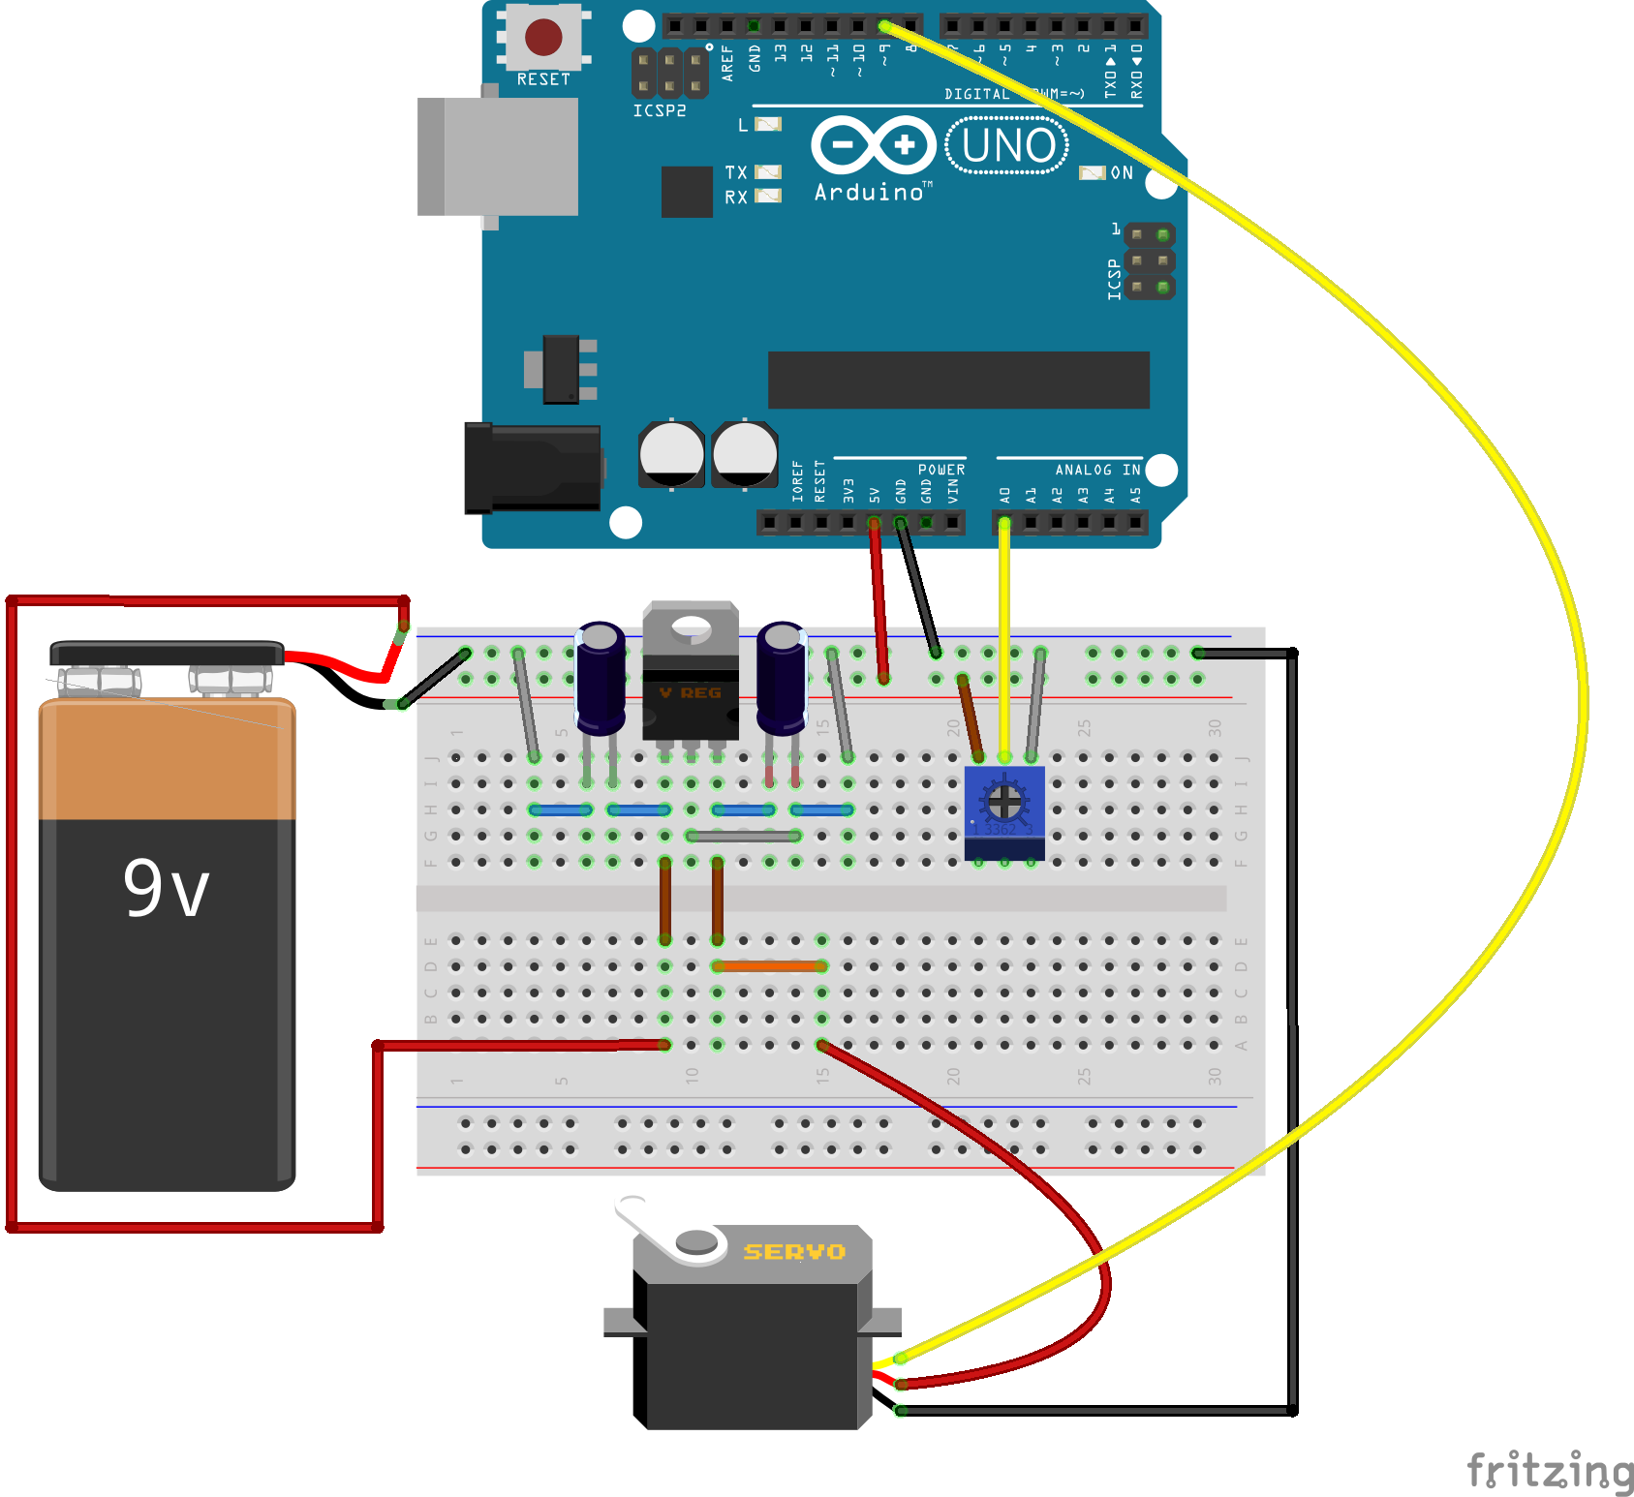
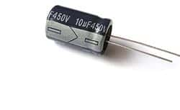
Lets wire up a servo (and regulator)
Notice the regulators orientation
Metal tab is in the “back”
Battery on the left most pin
Ground on center pin
Servo power on the rightmost pin
The capacitors are electrolytic and have a polarity. The stripe on the capacitors indicates negative terminal and should be connected to a common ground
stripe
10uF
0.1uF

Slide 31
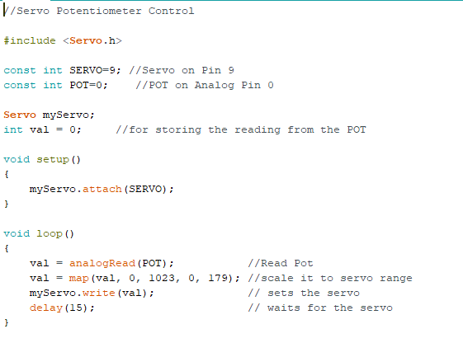
Download and run servo.ino
The Arduino library makes controlling servos easy
The statements
Include
Adds functionality of libraries (in this case Servo)
Servo myServo
Makes a servo object named “myServo”
If you have multiples you can call them all different names

Slide 32
Clean up
Disassemble the breadboard and wires for the next student and place it all back in the bag.
Return the bag to the lab manager.

Slide 33
Stay tuned
Arduino 4 will cover Serial Communications.
We’ll send temperature sensor data to the computer and display it using Java!

